Slide 1

A (quick) Journey through the Field of Quantum Computing
Florea Ioan-Albert, B.Sc.

Slide 2




Who am I?
Embedded Software Engineer @ NXP Semiconductors
Previously: Research Assistant in QC at the Chair for Design Automation (Prof. Robert Wille)
Currently focusing on a joint Master’s Thesis between TUM, LRZ and DLR
(German Aerospace)
Co-founder of RoQTeam
Computer Scientist by training (B.Sc. also at TUM)

Slide 3
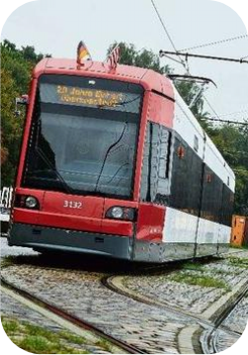
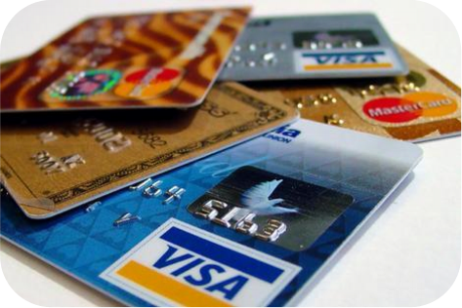
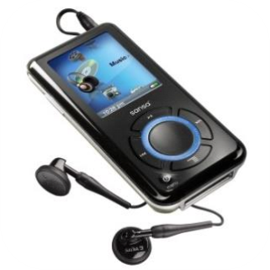
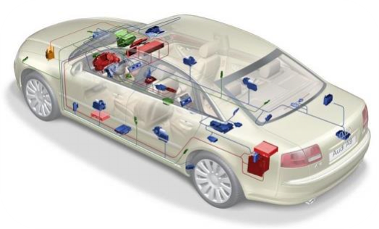
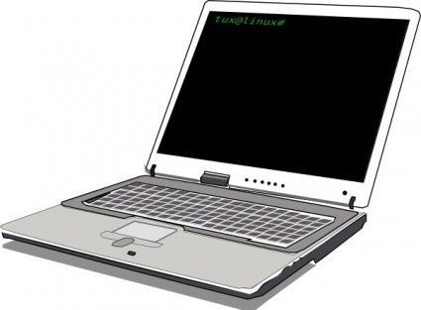
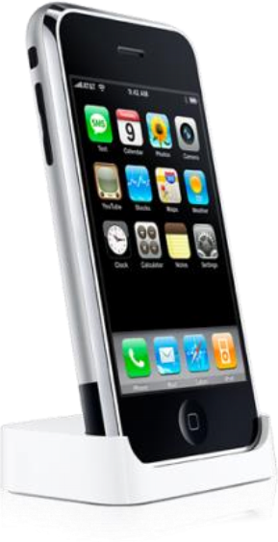

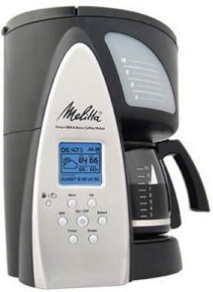
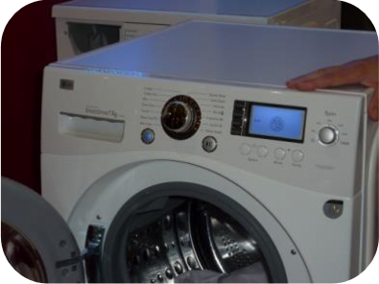
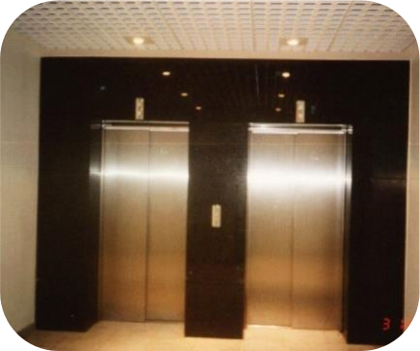
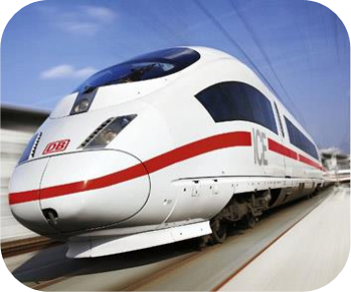
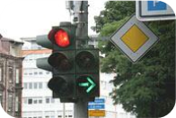
Conventional Computing

Slide 4

Conventional Computing

Slide 5
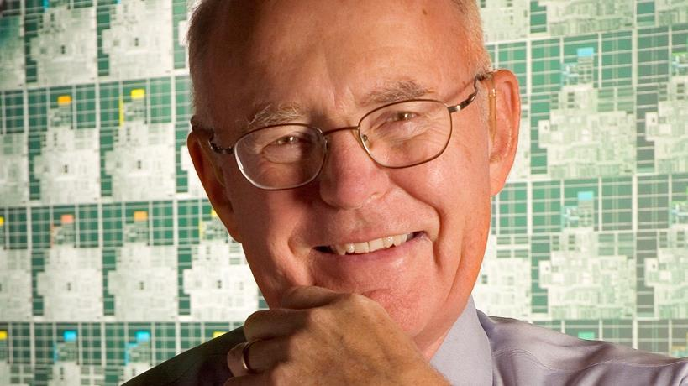
Past Development
Exponential growth of
integrated circuits! (Moore's Law)

Slide 6

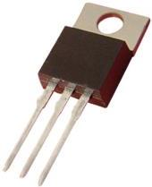
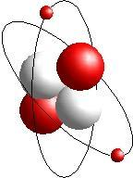

Leading to…
Transistors approaching the atomic scale?
=
Computer cooling as in nuclear power plants?
?
➔Today‘s technologies are approaching their limits!
Besides that…
Many problems remain hard for
today’s computing technologies
…even with further advancements.

Slide 7







Quantum Computing: The Next Big Thing
Huge interest…
□ from big Players: IBM, Google, Microsoft, Amazon, …
□ from Startups: AQT, Rigetti, IonQ, …
Exponential improvements in the best case
□ Integer factoring in polynomial time □ Break current internet cryptography
Various further application domains
□ Nature
□ Optimization
□ Finance
□ Machine Learning
□ …

Slide 8








Quantum Computing: Hardware Technologies
Superconductors
Trapped Ions
Photons
Neural Atoms
Silicon Spins/Quantum Dots

Slide 9
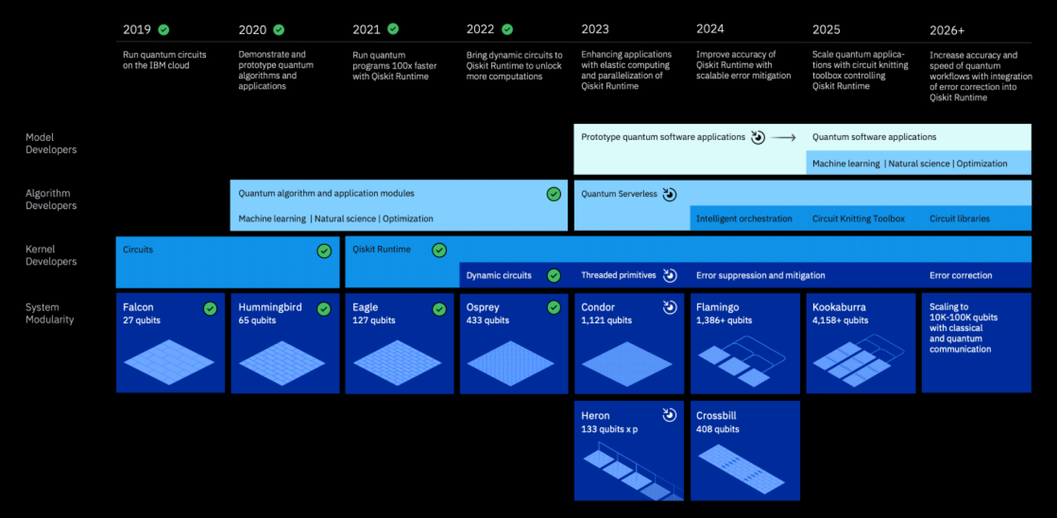
Roadmap IBM
24

Slide 10
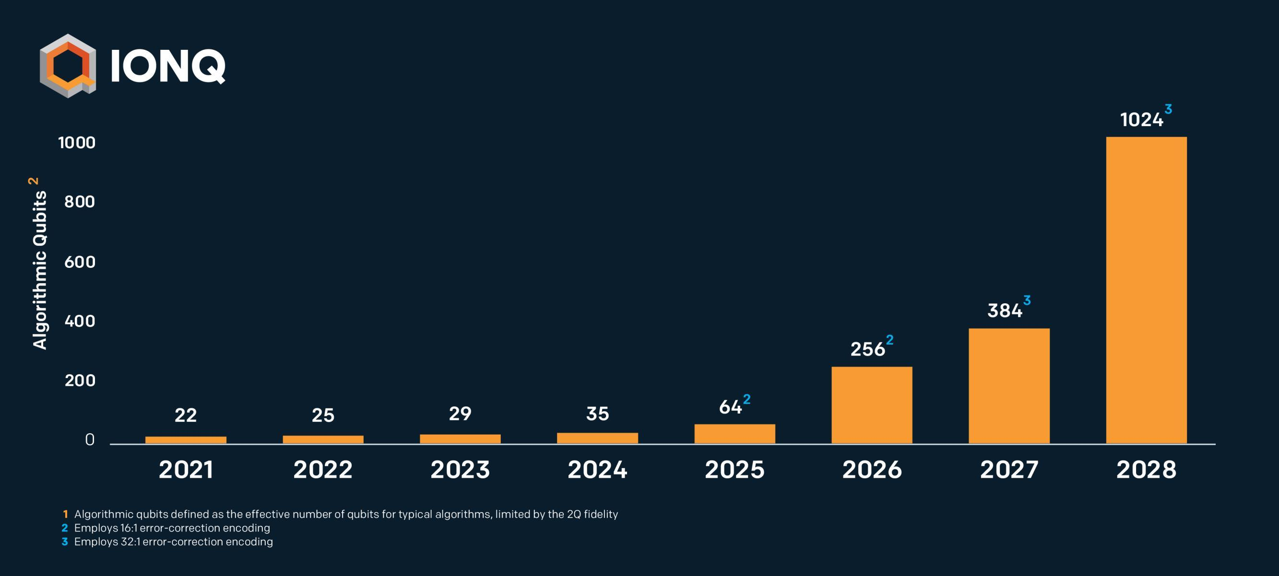
Roadmap IonQ
26

Slide 11
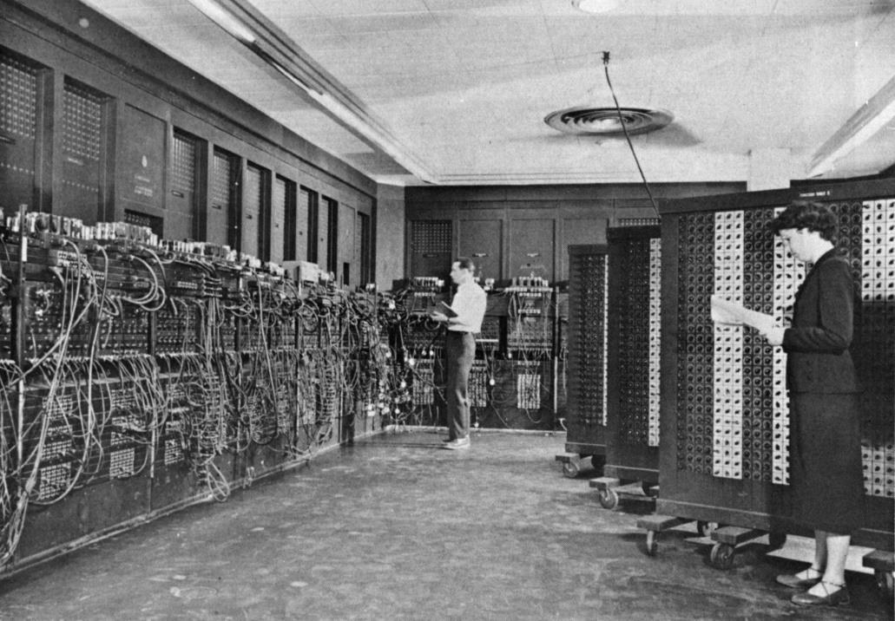
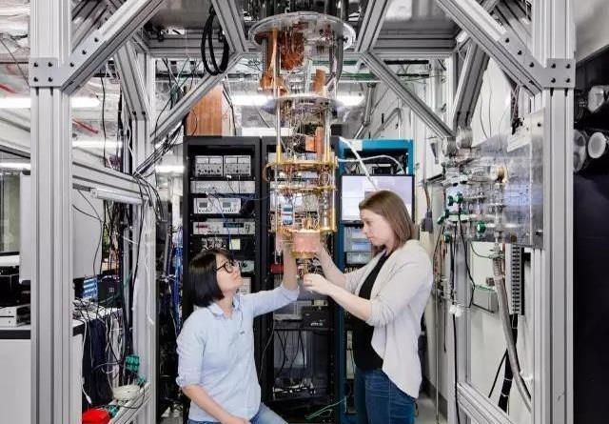
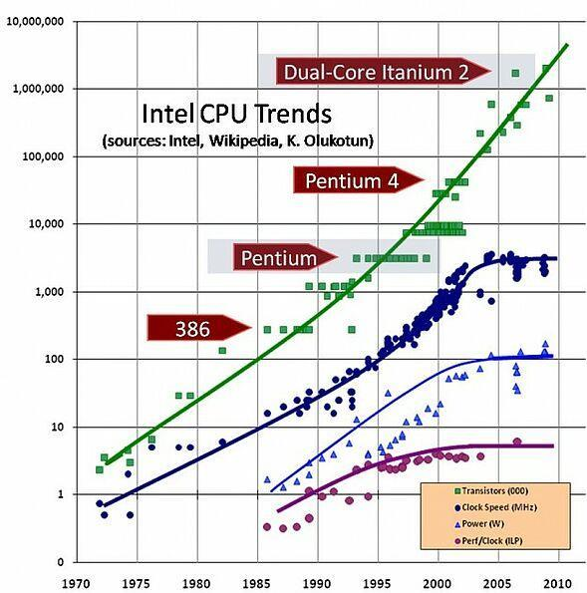
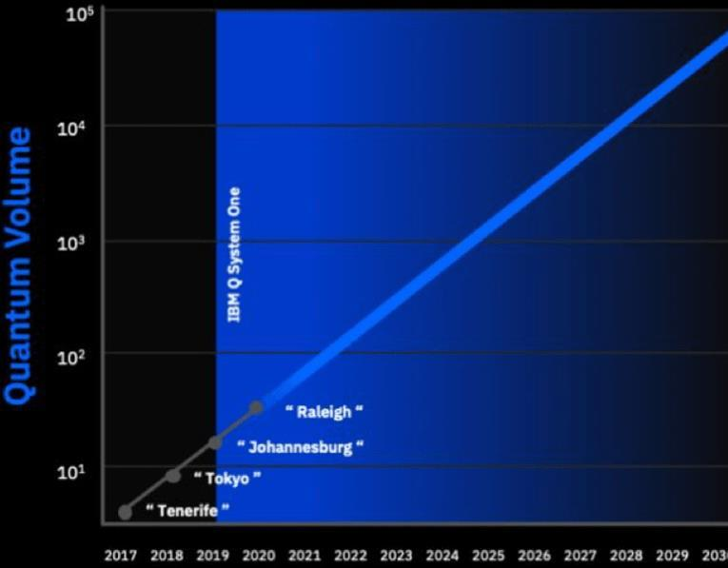
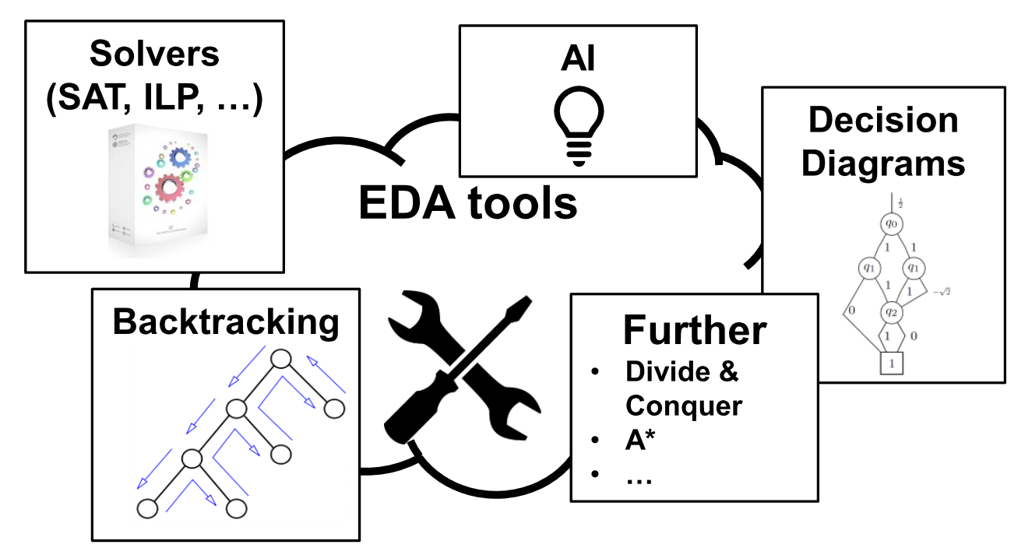
Analogy to Conventional Computers
Similar picture if we look back in time
□ First, bulky computers
□ Moores law
□ Digital revolution
EDA tools enabled their success
□ Handle problems with enormous complexity
27

Slide 12
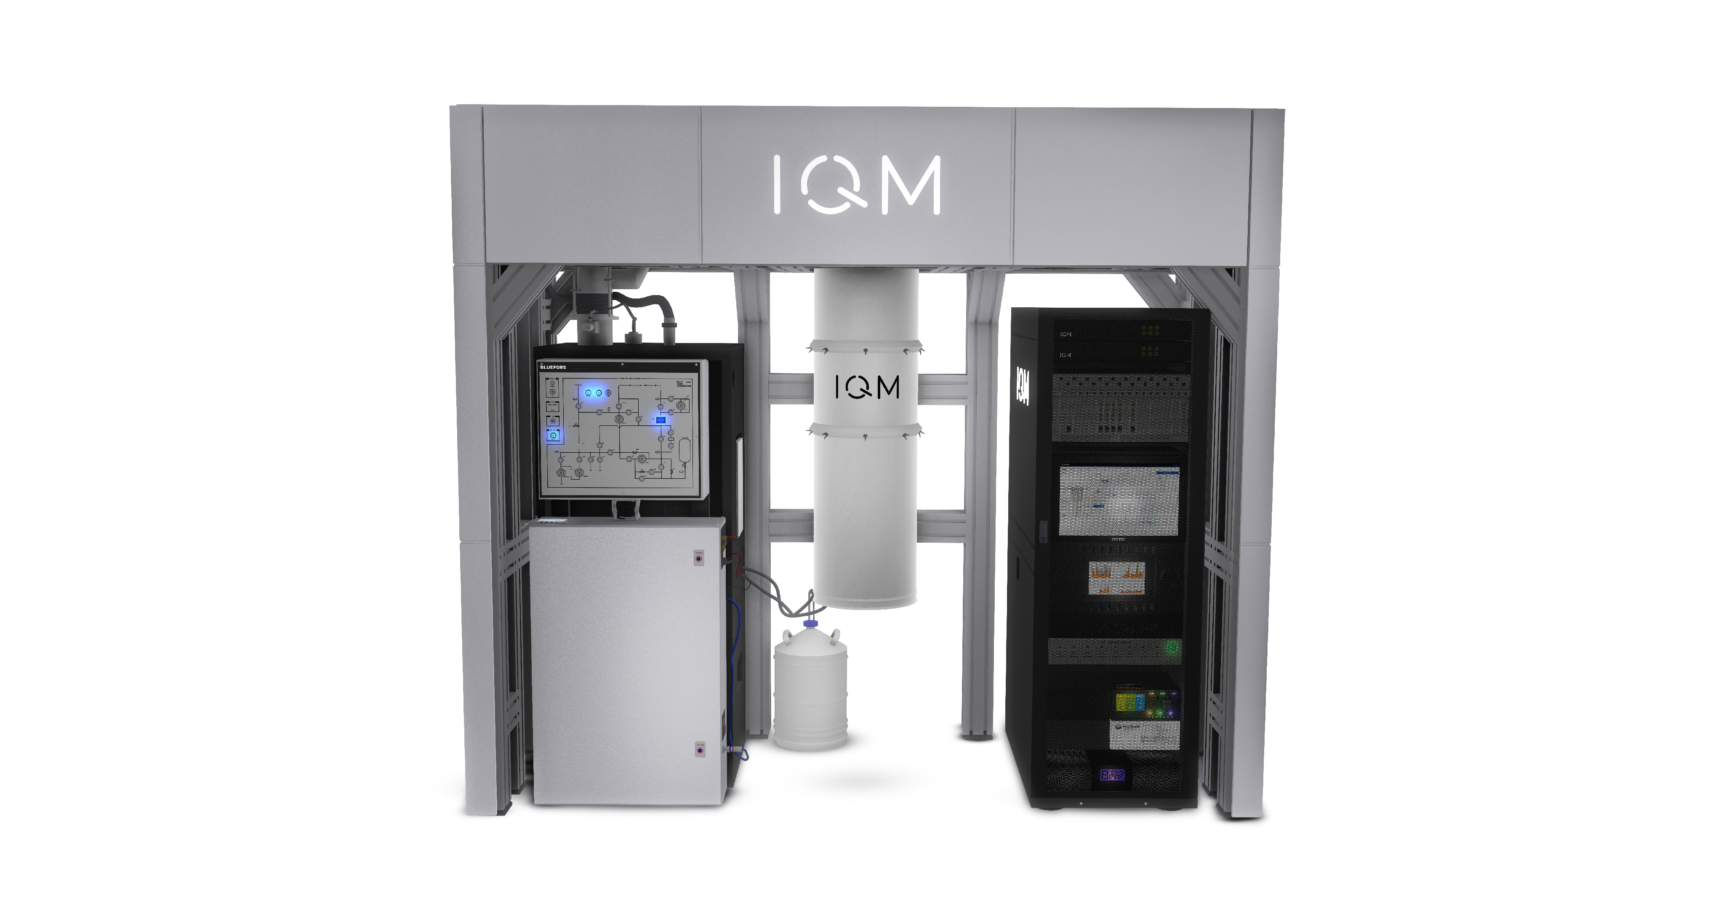

Slide 13
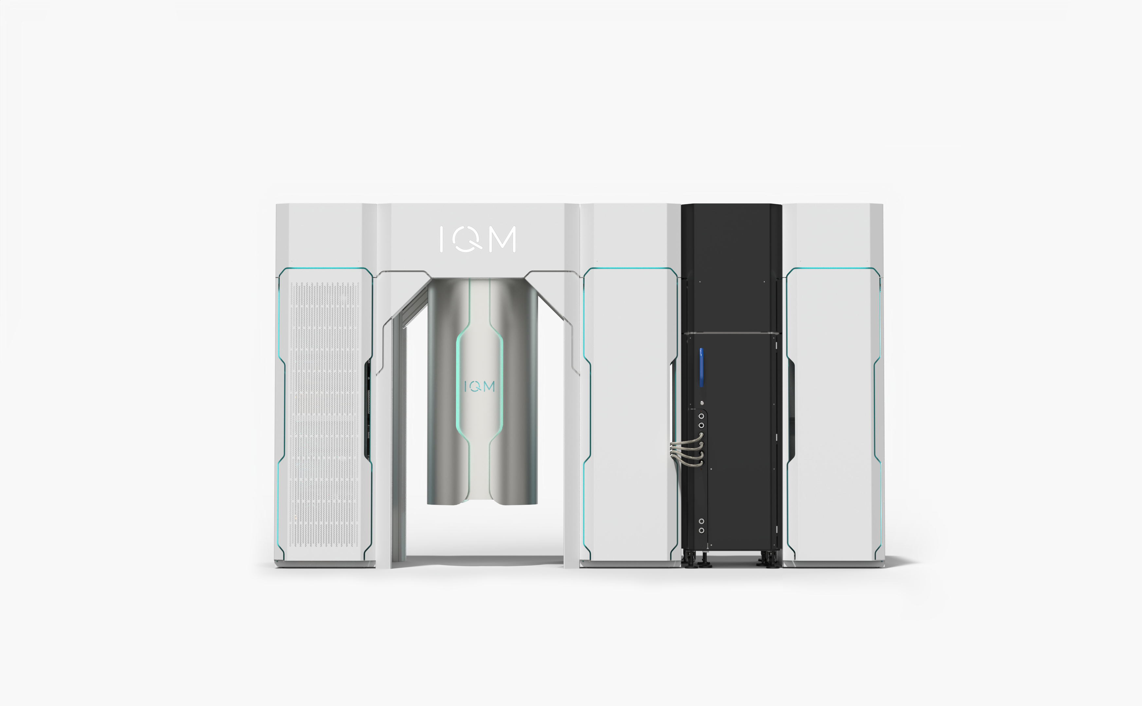

Slide 14
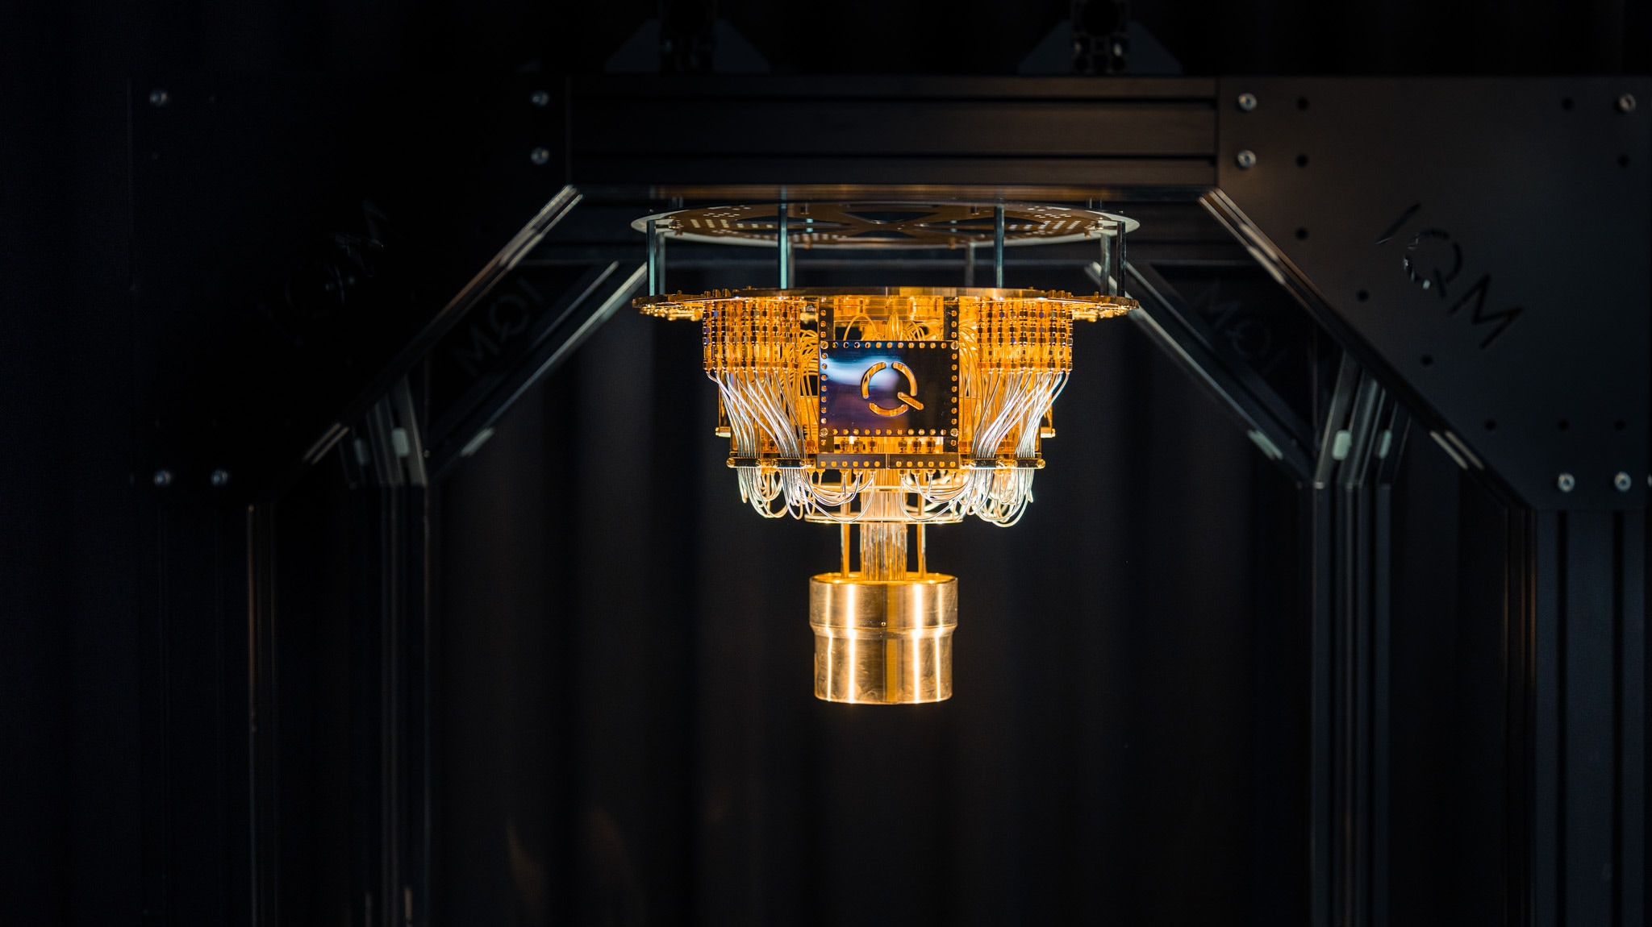

Slide 15
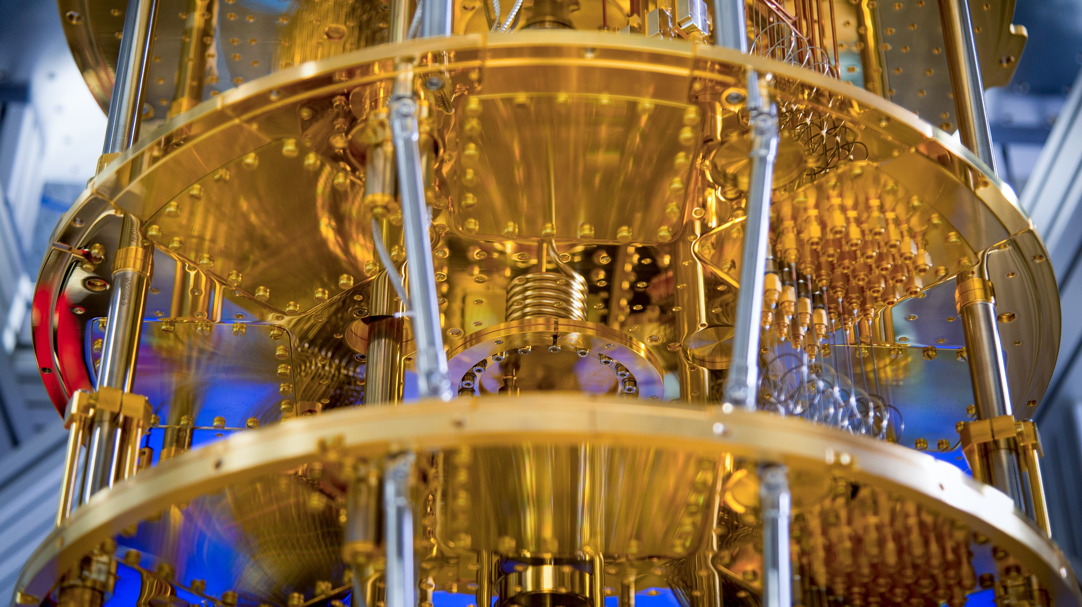

Slide 16
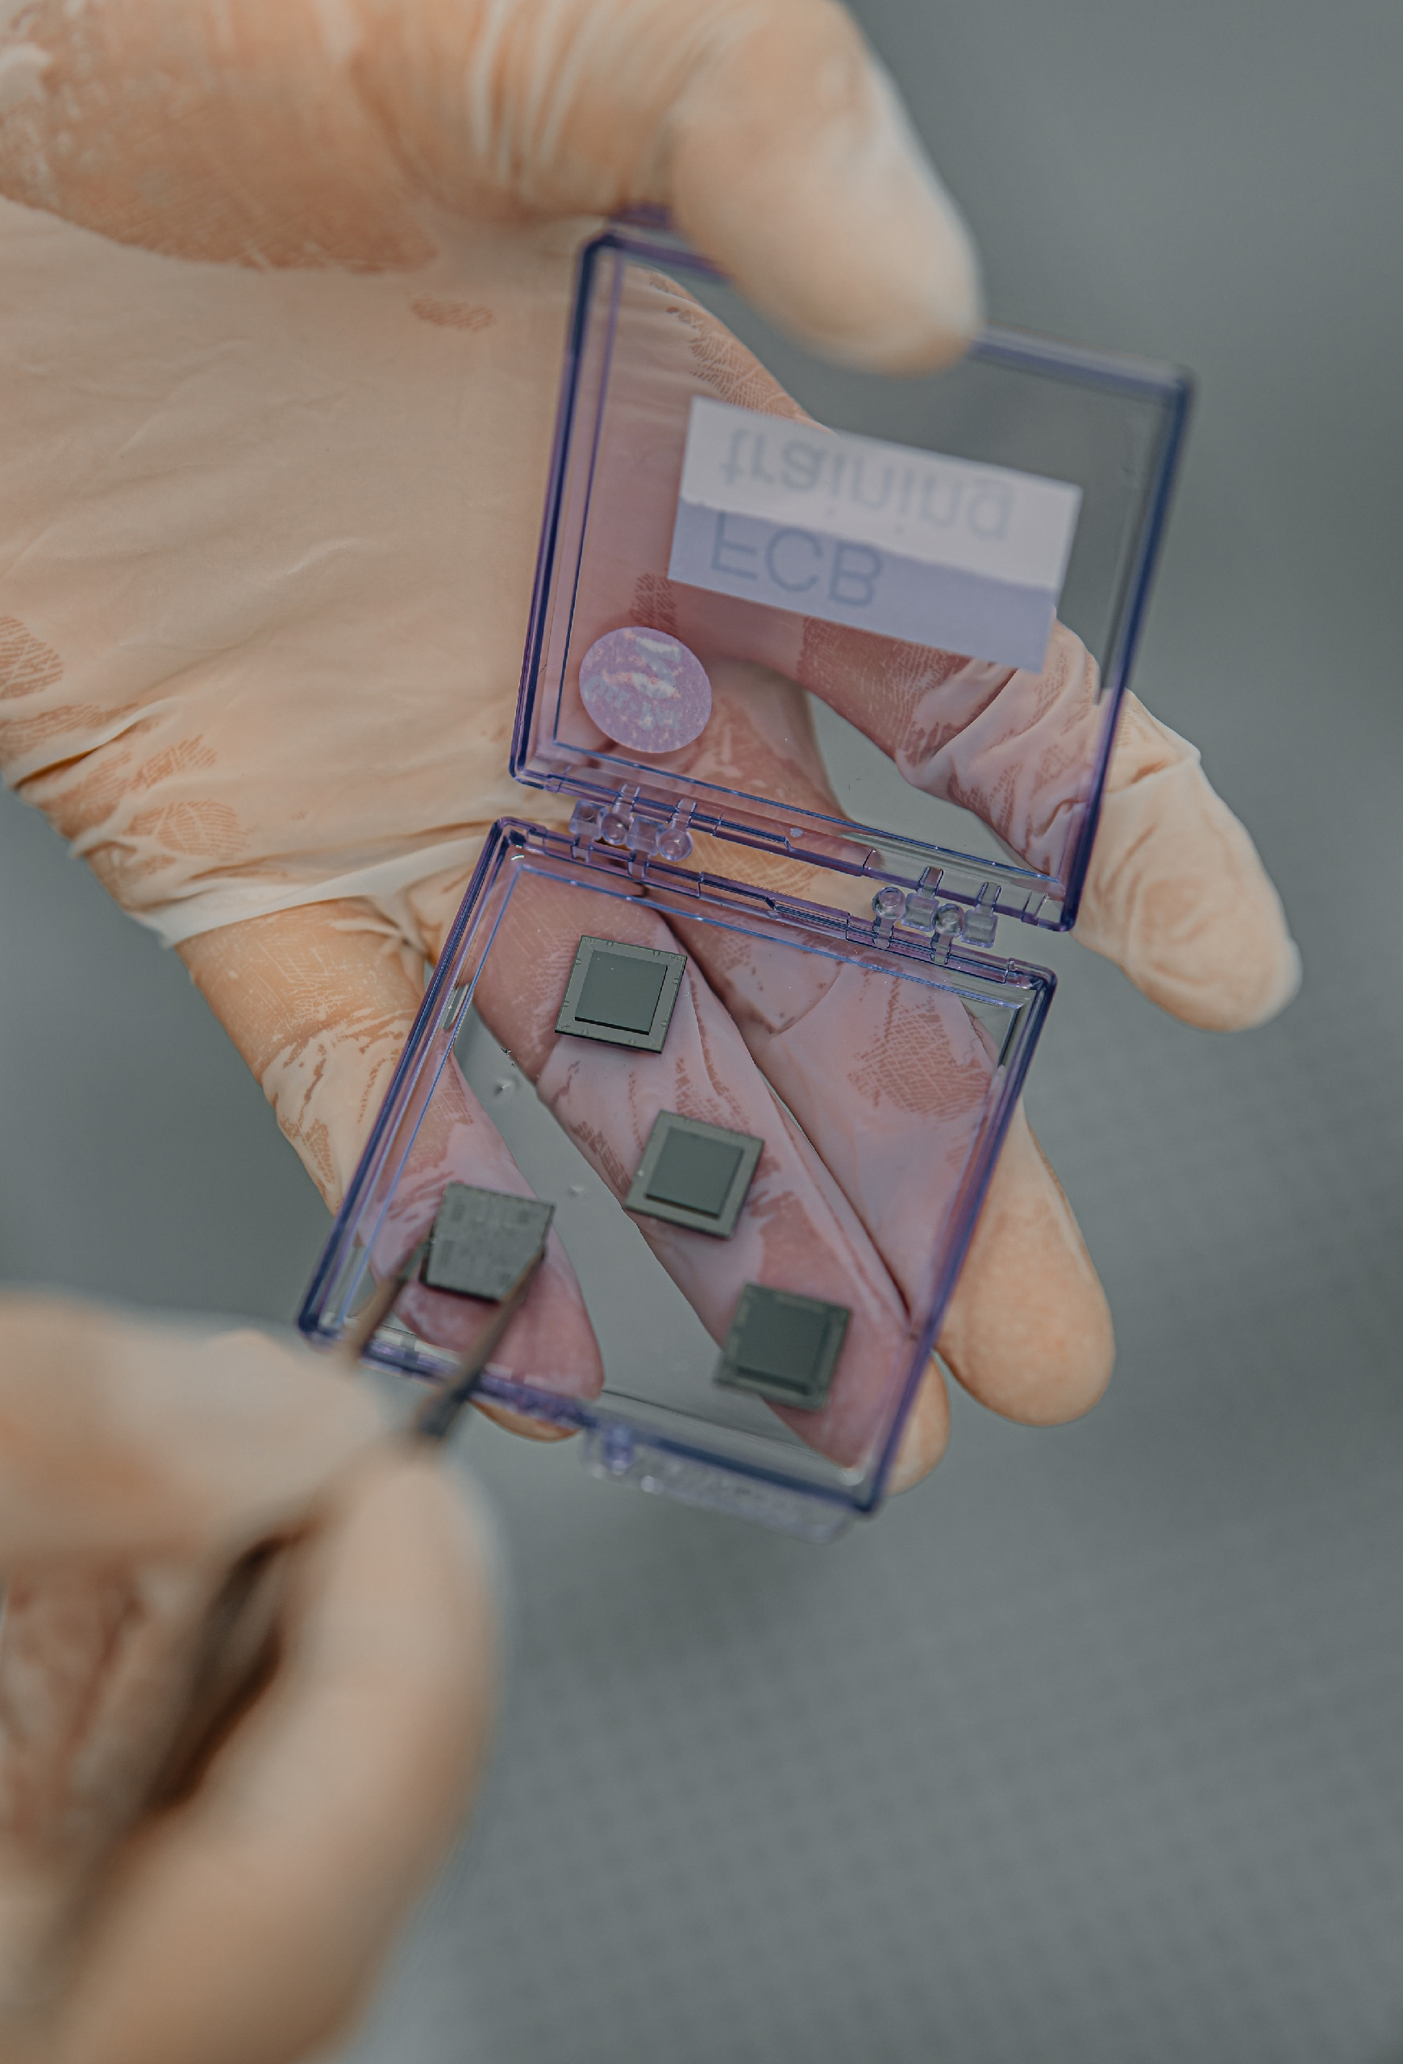
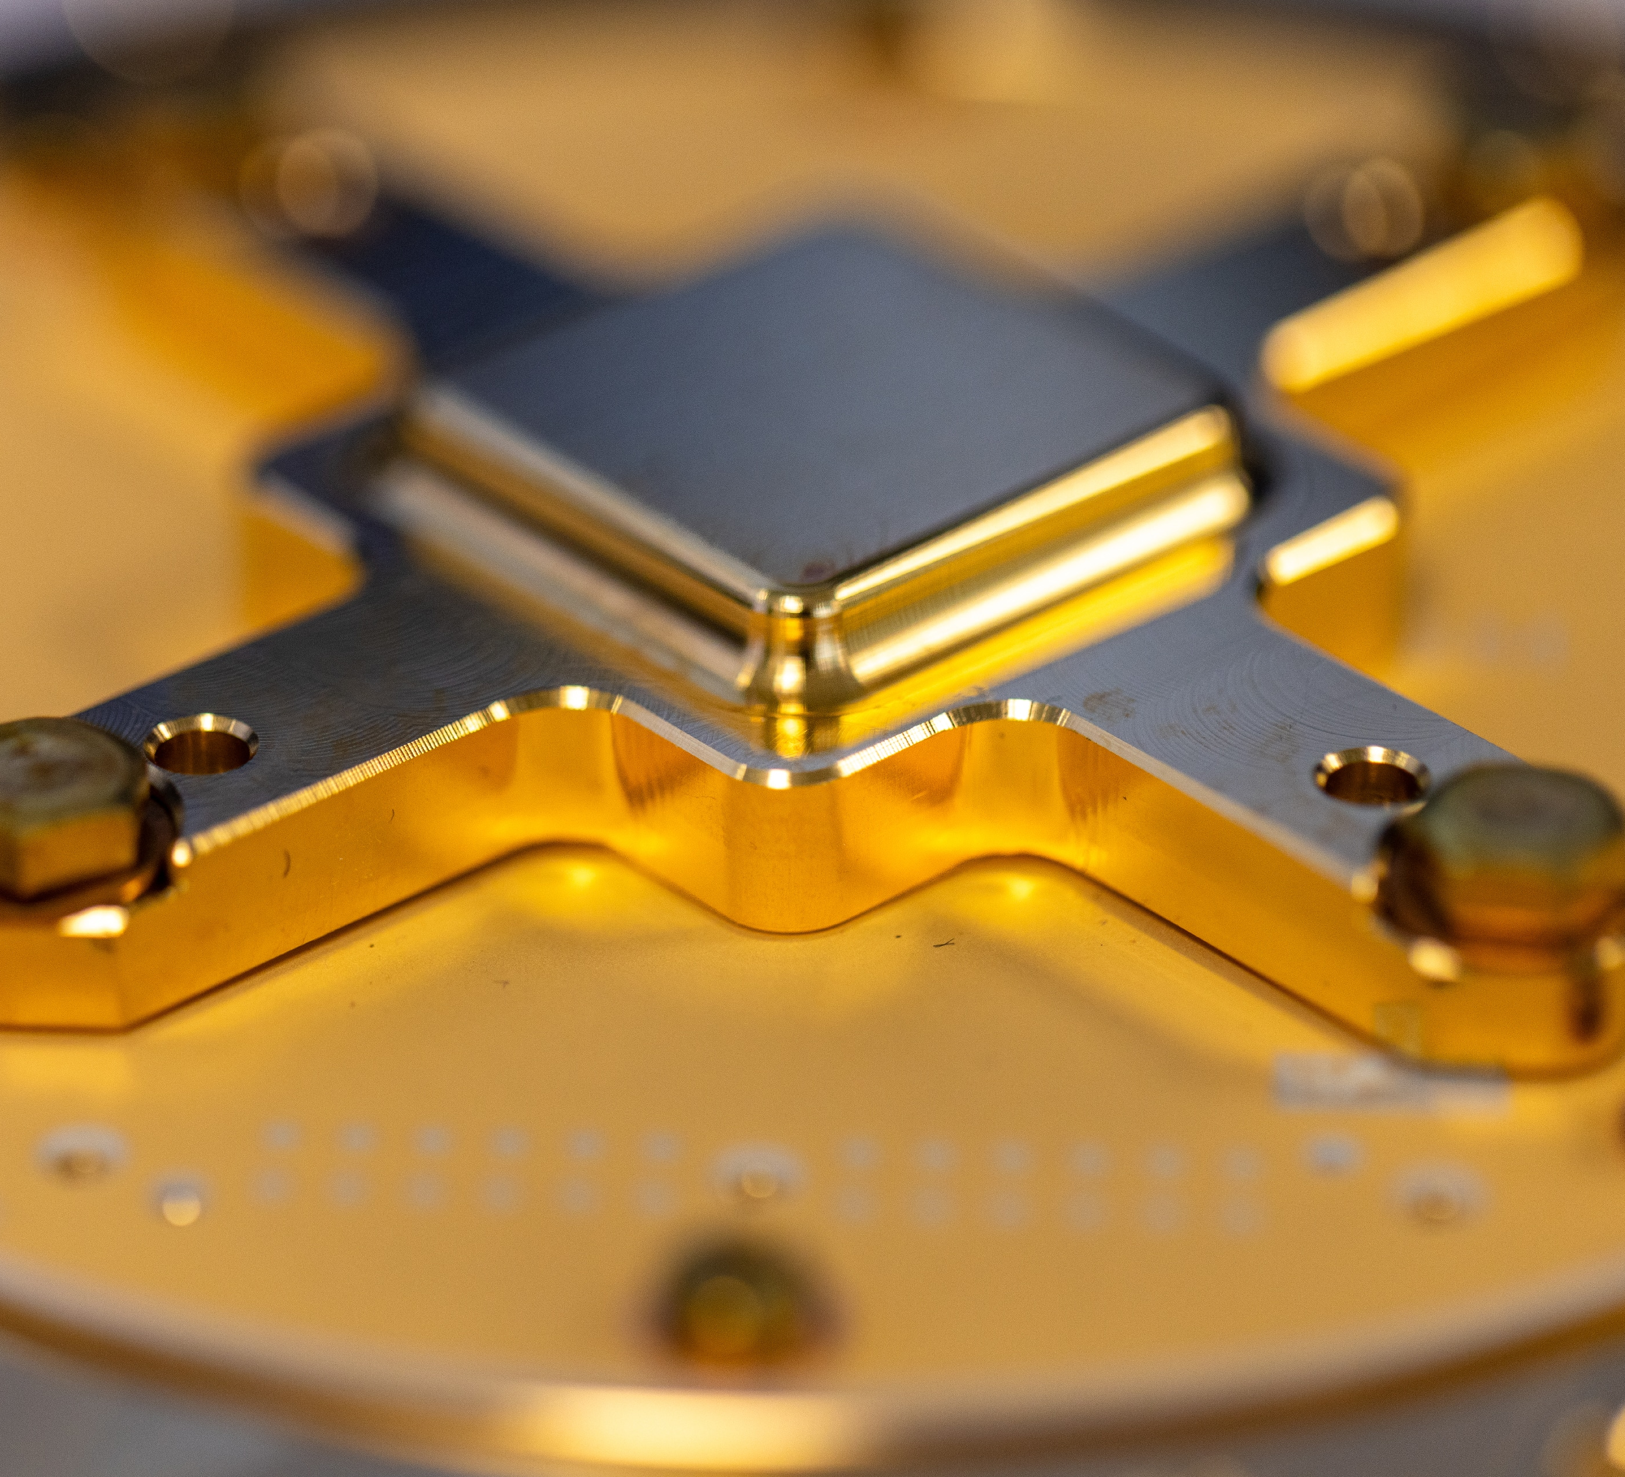

Slide 17


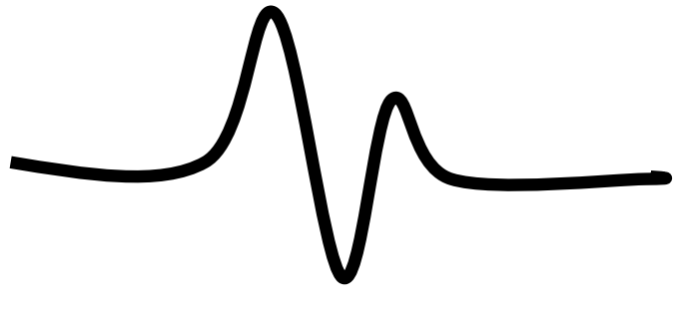
Conventional vs. Quantum Physics
Thus far: Newtonian Physics
  Describes “our world” (larger than the subatomic level)
  Based on particles
  Completely deterministic
Now: Quantum Mechanics
  Describes the smallest “things” in our universe
  Described by waves
  Completely probabilistic
  Allows to be in more than one state at once
  Measurement collapses back to a single state (back to “our” world)
  True random
  Entanglement

Slide 18
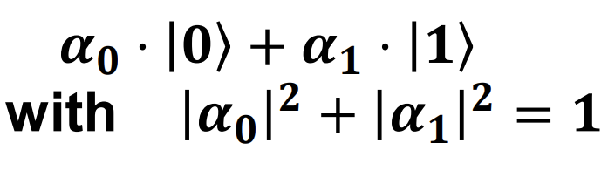

Conventional vs. Quantum Physics
Thus far: Newtonian Physics
  Describes “our world” (larger than the subatomic level)
  Based on particles
  Completely deterministic
Now: Quantum Mechanics
  Describes the smallest “things” in our universe
  Described by waves
  Completely probabilistic
  Allows to be in more than one state at once
  Measurement collapses back to a single state (back to “our” world)
  True random

Slide 19
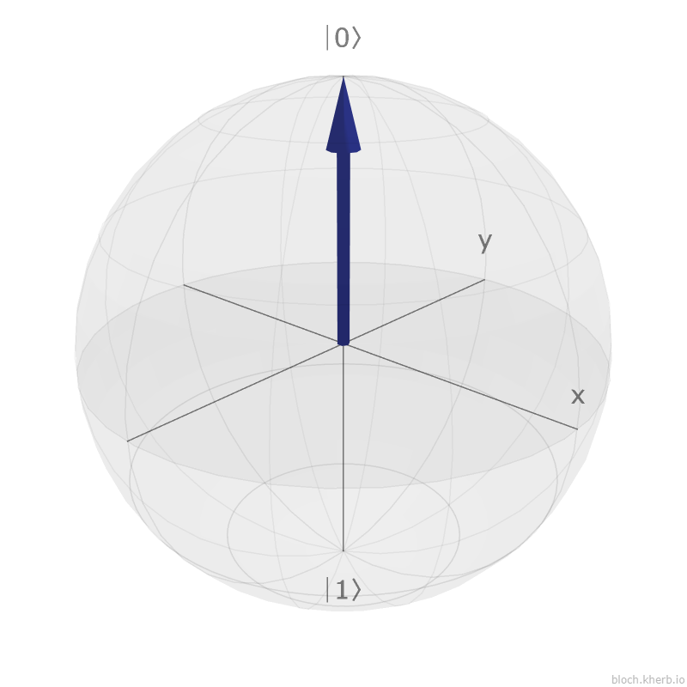

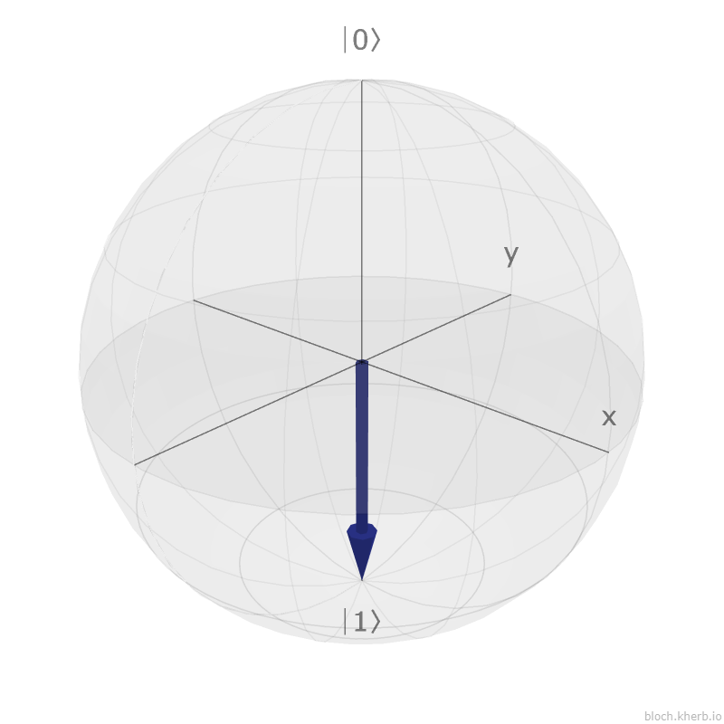
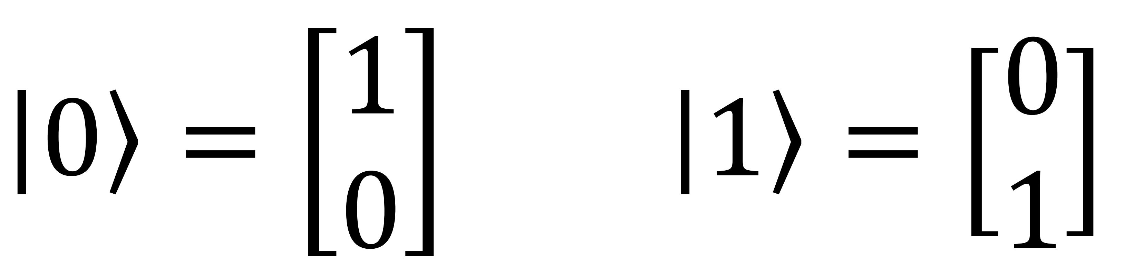
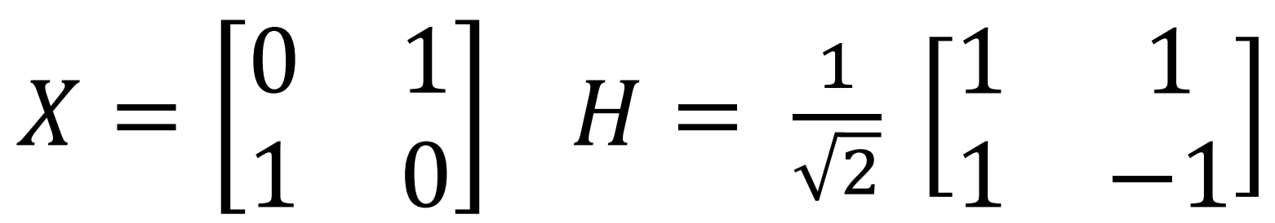
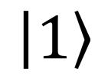
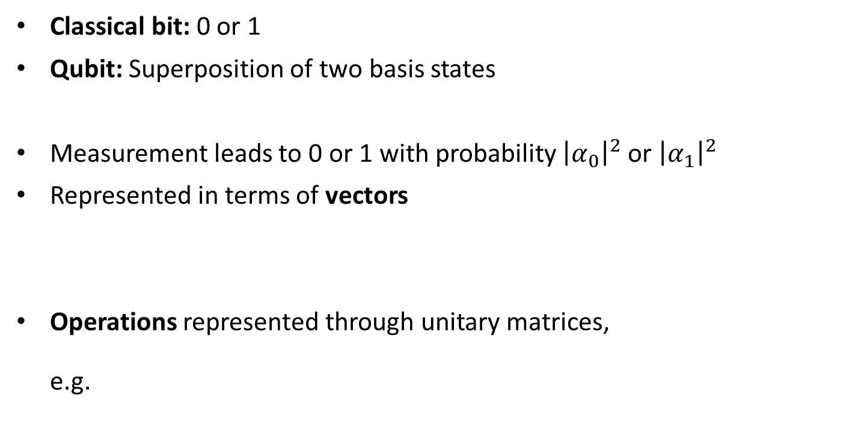
Conventional vs. Quantum Computing
Classical bit: 0 or 1
Qubit: Superposition of two basis states
Measurement leads to 0 or 1 with probability ${\left|α_{0}\right|}^{2}$ or ${\left|α_{1}\right|}^{2}$
Represented in terms of vectors
Operations represented through unitary matrices,
e.g.
Qubit
Qubit

Slide 20
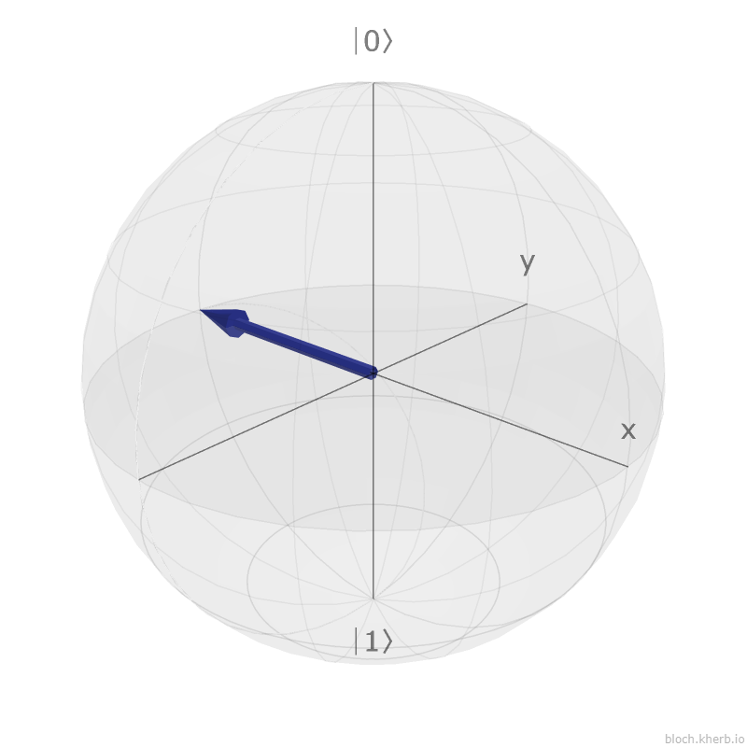
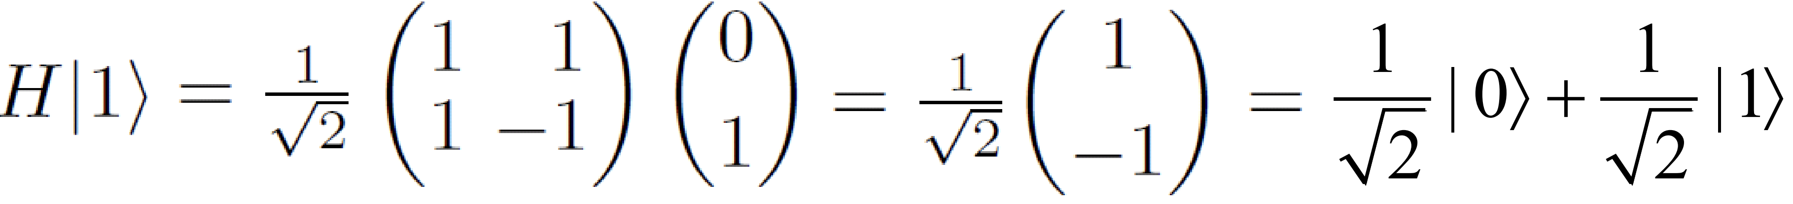
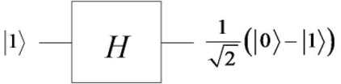
Example of Applying an Operation to a Qubit
Applying the H gate to the |1> basis state would result in the
following state:
The quantum circuit for the above computation looks as follows:

Slide 21
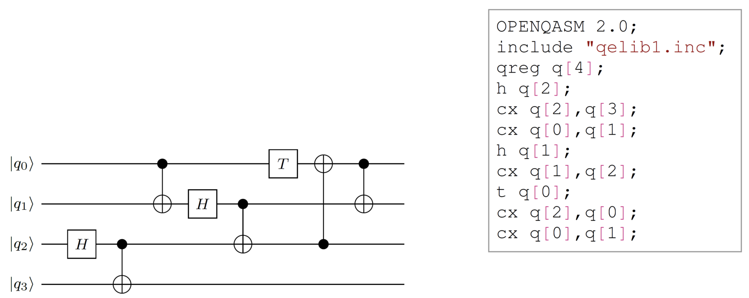
Quantum Circuits / Quantum Software
Cascades of quantum gates working on qubits
Quantum gates may either be unary gates or working on two gates with a control qubit (black dot) and a target qubit

Slide 22
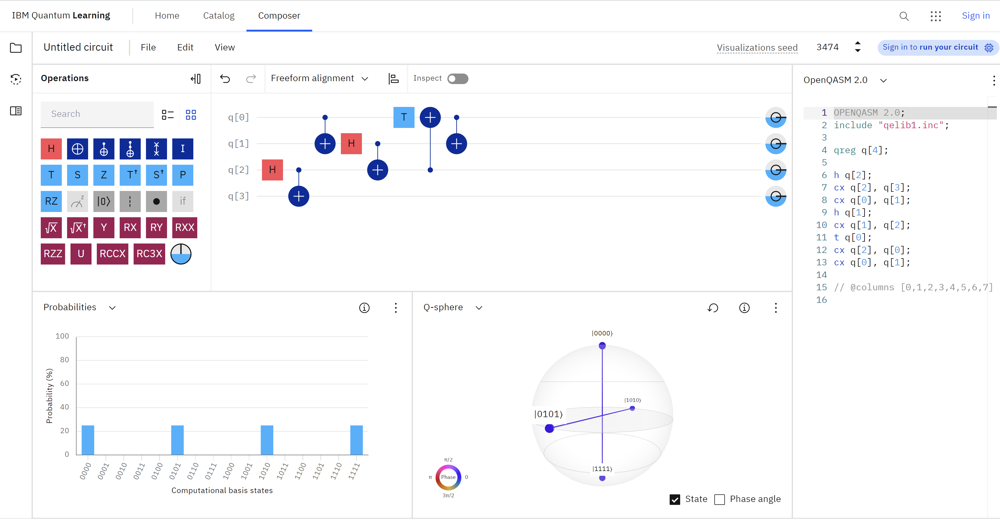

Slide 23
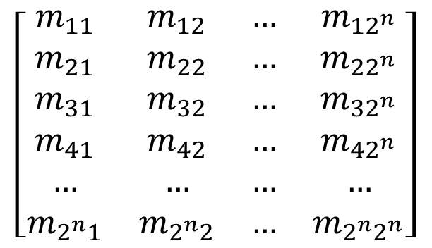
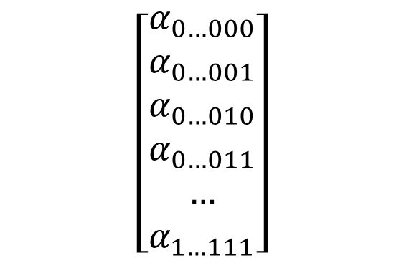
The Basis of the Software for Quantum Computing…
…are vectors and matrices!
Can be represented by 1- or 2-dimensional arrays
(problem: exponential complexity)
Solution for classical simulation: Decision Diagrams
$$\left[\begin{matrix}m_{11} & m_{12} & … & m_{12^{n}} \\ m_{21} & m_{22} & … & m_{22^{n}} \\ m_{31} & m_{32} & … & m_{32^{n}} \\ m_{41} & m_{42} & … & m_{42^{n}} \\ … & … & … & … \\ m_{2^{n}1} & m_{2^{n}2} & … & m_{2^{n}2^{n}}\end{matrix}\right]$$
$$\left[\begin{aligned}α_{0…000} \\ α_{0…001} \\ α_{0…010} \\ α_{0…011} \\ … \\ α_{1…111}\end{aligned}\right]$$

Slide 24
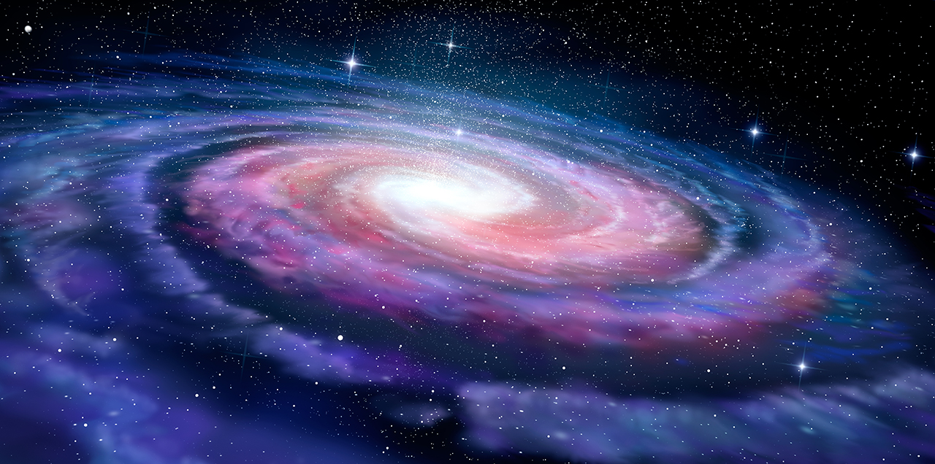


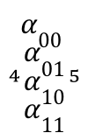




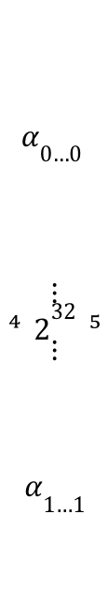

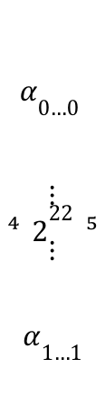



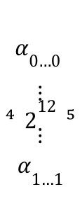


Complexity
$$\left[\begin{matrix}α_{0…0} \\ \begin{matrix}\begin{matrix}\begin{matrix}\begin{matrix}\begin{matrix}\begin{matrix}\begin{matrix}\begin{matrix}\begin{matrix}\begin{matrix} \\ \\ \end{matrix} \\ \\ \end{matrix} \\ \\ \end{matrix} \\ \\ \end{matrix} \\ \\ \end{matrix} \\ \end{matrix} \\ \end{matrix} \\ \end{matrix} \\ ⋮\end{matrix} \\ 2^{305} \\ \begin{matrix}⋮ \\ \begin{matrix}\begin{matrix}\begin{matrix}\begin{matrix}\begin{matrix} \\ \\ \end{matrix} \\ \\ \end{matrix} \\ \end{matrix} \\ \end{matrix} \\ \begin{matrix} \\ \end{matrix}\end{matrix}\end{matrix}\end{matrix} \\ α_{1…1}\end{matrix}\right]$$
Quantum Computing
$$\left[\begin{matrix}α_{0…0} \\ \begin{matrix}\begin{matrix}\begin{matrix}\begin{matrix}\begin{matrix}\begin{matrix}\begin{matrix} \\ \end{matrix} \\ \\ \end{matrix} \\ \end{matrix} \\ \end{matrix} \\ \end{matrix} \\ ⋮\end{matrix} \\ 2^{42} \\ \begin{matrix}⋮ \\ \begin{matrix}\begin{matrix}\begin{matrix} \\ \end{matrix} \\ \end{matrix} \\ \begin{matrix} \\ \begin{matrix} \\ \\ \end{matrix}\end{matrix}\end{matrix}\end{matrix}\end{matrix} \\ α_{1…1}\end{matrix}\right]$$
$$\left[\begin{matrix}α_{0…0} \\ \begin{matrix}\begin{matrix}\begin{matrix}\begin{matrix} \\ \end{matrix} \\ \begin{matrix} \\ \\ \end{matrix}\end{matrix} \\ ⋮\end{matrix} \\ 2^{32} \\ \begin{matrix}⋮ \\ \begin{matrix}\begin{matrix} \\ \\ \end{matrix} \\ \begin{matrix} \\ \end{matrix}\end{matrix}\end{matrix}\end{matrix} \\ α_{1…1}\end{matrix}\right]$$
$$\left[\begin{matrix}α_{0…0} \\ \begin{matrix}\begin{matrix}\begin{matrix}\begin{matrix} \\ \end{matrix} \\ \end{matrix} \\ ⋮\end{matrix} \\ 2^{22} \\ \begin{matrix}⋮ \\ \begin{matrix}\begin{matrix} \\ \end{matrix} \\ \end{matrix}\end{matrix}\end{matrix} \\ α_{1…1}\end{matrix}\right]$$
$$\left[\begin{matrix}α_{0…0} \\ \begin{matrix}\begin{matrix} \\ ⋮\end{matrix} \\ 2^{12} \\ \begin{matrix}⋮ \\ \end{matrix}\end{matrix} \\ α_{1…1}\end{matrix}\right]$$
$$\left[\begin{matrix}α_{00} \\ \begin{matrix}α_{01} \\ α_{10}\end{matrix} \\ α_{11}\end{matrix}\right]$$
$$2$$
$$12$$
$$22$$
$$32$$
$$42$$
$$305$$
#qubits
memory
$64$KiB
$64$MiB
$64$GiB
$64$TiB
$64$B
by hand
L1 cache
L3 cache
RAM
HPC

Slide 25

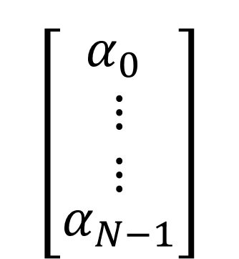

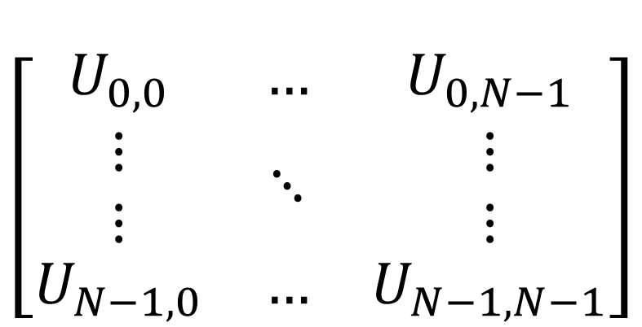
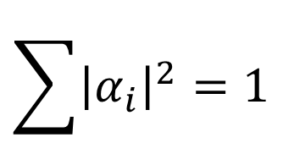



Classical Simulation of Quantum Circuits
Quantum Operation
Quantum State
Evolved Quantum State
Q
$$\left[\begin{matrix}U_{0,0} & … & U_{0,N−1} \\ \begin{matrix}⋮ \\ ⋮\end{matrix} & ⋱ & \begin{matrix}⋮ \\ ⋮\end{matrix} \\ U_{N−1,0} & … & U_{N−1, N−1}\end{matrix}\right]$$
$$\left[\begin{matrix}{α′}_{0} \\ \begin{matrix}⋮ \\ ⋮\end{matrix} \\ {α′}_{N−1}\end{matrix}\right]$$
ASM
$$\left[\begin{matrix}α_{0} \\ \begin{matrix}⋮ \\ ⋮\end{matrix} \\ α_{N−1}\end{matrix}\right]$$
OPENQASM 2.0;
include "qelib1.inc";
qreg q[3];
creg c[3];
h q[2];
cx q[2], q[1];
cx q[2], q[0];
measure q[2] -> c[2];
1110
0110
0001
1001
$$×$$
$$U_{i,j}∈ℂ$$
$$α_{i}∈ℂ$$
$$\sum{{\left|α_{i}\right|}^{2}=1}$$
$$U^{†}U=I$$

Slide 26










Classical Simulation of Quantum Circuits
Initial State
$$|0…0⟩$$
for every operation …
Final State
$$|ψ⟩$$
$$\left[\begin{matrix}1 \\ \begin{matrix}0 \\ ⋮\end{matrix} \\ 0\end{matrix}\right]$$
$$\left[\begin{matrix}U_{0,0} & … & U_{0,N−1} \\ \begin{matrix}⋮ \\ ⋮\end{matrix} & ⋱ & \begin{matrix}⋮ \\ ⋮\end{matrix} \\ U_{N−1,0} & … & U_{N−1, N−1}\end{matrix}\right]$$
$$\left[\begin{matrix}α_{0} \\ \begin{matrix}⋮ \\ ⋮\end{matrix} \\ α_{N−1}\end{matrix}\right]$$
$$\left[\begin{matrix}{α′}_{0} \\ \begin{matrix}⋮ \\ ⋮\end{matrix} \\ {α′}_{N−1}\end{matrix}\right]$$
$$\left[\begin{matrix}α_{0} \\ \begin{matrix}⋮ \\ ⋮\end{matrix} \\ α_{N−1}\end{matrix}\right]$$
$$×$$
$|i⟩$ with probability ${\left|α_{i}\right|}^{2}$

Slide 27












Exploiting Knowledge about the Compilation Flow
Conceptional algorithm
Target Device
Limited Gate Set
Synthesis
Limited Connectivity
Mapping
Limited Fidelity and Coherence
Optimizations
easy to incorporate
Actual Realization
necessary
potentially hard
21

Slide 28


Example: Topology and Characteristics IBM Seattle
14

Slide 29



Example: Topology and Characteristics IonQ Harmony
16

Slide 30
Software for Quantum Computing
Application
Simulation
Compilation
Verification
Error Correction
Hardware
Data Structures & Core Methods

Slide 31





Software for Quantum Computing
Application
Compilation
Error Correction
Workflow from classical problem to quantum solution
Automated encoding, execution & decoding
Automatic device selection
Compiler optimization
Technology-specific compilation
Reversible synthesis
Decoding algorithms
Fault-tolerant state preparation
Automated code construction and numerical simulations
Application
Simulation
Compilation
Verification
Error Correction
Hardware
Simulation
Verification
Hardware
Classical simulation of quantum circuits based on decision diagrams
Includes sampling, noise-aware simulation, Hybrid Schrödinger Feynman approaches, approximation strategies, expectation value computations, etc.
Equivalence checking
Verifying compilation results
Application specific physical design for superconducting platform
=
Data Structures & Core Methods
Check it out!
Efficient data structures
Dedicated core methods (optimal and heuristic)
Based on C++ and Python
Decision
Diagrams
Tensor
Networks
ZX-Calculus
SAT/SMT
Solvers
Machine Learning
Heuristics
https://mqt.readthedocs.io

Slide 32














The Munich Quantum Toolkit (MQT)
All tools are available as open-source repositories on GitHub under the MIT license
MQT ProblemSolver
MQT Bench
MQT QUBOMaker
MQT YAQS
Application
Application
Application
Simulation
A Tool for Solving Problems Using Quantum Computing
Benchmarking Software and Tools for Quantum Computing
A Framework for the Automatic Generation of QUBO Formulations
A Tool for Simulating Open Quantum Systems, Noisy Quantum Circuits, and Realistic Quantum Hardware
github.com/
munich-quantum-toolkit/problemsolver
PyPI
www.cda.cit.tum.de/mqtbench
github.com/
munich-quantum-toolkit/bench
PyPI
PyPI
PyPI
github.com/cda-tum/mqt-qubomaker
github.com/
munich-quantum-toolkit/yaqs
MQT DDSIM
MQT Predictor
MQT IonShuttler
MQT Qudits
Simulation
Compilation
Compilation
Compilation
A Tool for Classical Quantum Circuit Simulation based on Decision Diagrams
A Tool for Determining Good Quantum Circuit Compilation Options
A Tool for Generating Shuttling Schedules for QCCD Architectures
A Tool for Compiling
High-Dimensional Quantum Systems
github.com/
munich-quantum-toolkit/ddsim
github.com/
munich-quantum-toolkit /predictor
github.com/
cda-tum/mqt-ion-shuttler
github.com/cda-tum/mqt-qudits
PyPI
PyPI
PyPI
PyPI
PyPI
MQT SyReC
MQT QMAP
MQT QCEC
MQT Debugger
Compilation
Compilation
Verification
Verification
A Tool for the Synthesis of Reversible Circuits/Quantum Computing Oracles
A Tool for Quantum Circuit Mapping
And Clifford Circuit Optimization/Synthesis
A Tool for
Quantum Circuit Equivalence Checking
A semi-automated tool for debugging quantum programs
github.com/
munich-quantum-toolkit/syrec
PyPI
github.com/
munich-quantum-toolkit/qmap
PyPI
github.com/
munich-quantum-toolkit/qcec
PyPI
github.com/
munich-quantum-toolkit/debugger
PyPI
MQT DDVis
MQT Core
MQT NAViz
MQT QECC
Data Structures
Data Structures
Core Methods
QECC
A Web-Application visualizing Decision Diagrams for Quantum Computing
The Backbone of the MQT
Intermediate Representation (IR)
Decision Diagram and ZX Package
A visualization software for neutral atom quantum computers.
A Tool for
Quantum Error Correcting Codes
www.cda.cit.tum.de/app/ddvis
github.com/
munich-quantum-toolkit/core
PyPI
github.com/
munich-quantum-toolkit/naviz
PyPI
github.com/
munich-quantum-toolkit/qecc
PyPI
Over 1k ⭐️ on GitHub
Over 2 Million Downloads on PyPI
https://mqt.readthedocs.io
@
@

Slide 33







Overview: Software Tooling for Quantum
Programming Language(s): Python, (C++, Rust, etc.)
Different categories of SDK providers:
  Quantum SDK and Quantum Computers
  (e.g. IBM/Qiskit, Google/Cirq,
  Quantinuum/Pytket, Xanadu/Pennylane, …)
  Quantum SDK and platform
  (Microsoft Azure, AWS Braket, …)
  Only Quantum SDK
  (e.g. MQT, Classiq, …)
Functionalities of SDKs similar with differences in
the details, such as syntax, supported simulators
or quantum computers
Simulator vs. actual Quantum Computer

Slide 34




The Current State
Individual
Physics
Researcher
Quantum
Device
I want to tune the pulse to execute an X-gate!

Slide 35



The Vision
I want to execute my algorithm with the best performance and fidelity!
Individual
Physics
Researcher
Comprehensive
Software Stack
Many/Different
Quantum Devices
Domain Experts
Quantum
Device

Slide 36
The Vision
I want to execute my algorithm with the best performance and fidelity!
Individual
Physics
Researcher
Comprehensive
Software Stack
Many/Different
Quantum Devices
Domain Experts
Quantum
Device
❌ What we do not want

Slide 37



The Vision
I want to execute my algorithm with the best performance and fidelity!
Individual
Physics
Researcher
Comprehensive
Software Stack
Many/Different
Quantum Devices
Domain Experts
Quantum
Device
IR
✅ What we want

Slide 38

Quantum Compilers in HPCQC
Burgholzer et al., The Munich Quantum Software Stack, arXiv:2509.02674 (2025)

Slide 39



How to get started?
Quantum Computation and Quantum Information – Nielsen & Chuang
Quantum Mechanics | The Theoretical Minimum
(by Leonard Susskind, Stanford YT Channel)
IBM Quantum Learning platform and Qiskit Youtube channel
(Qiskit Summer Camp, Understanding Quantum Information and Computation Series, Coding with Qiskit, etc.)
Codebook and Challenges from Pennylane

Slide 40
Thank you for your time!

Slide 41
References and Bibliography
https://bloch.kherb.io/
https://review.mastersunion.org/wp-content/uploads/2022/06/Quantum-and-classical-computer-1.gif
https://devopedia.org/images/article/68/4882.1613047200.jpg
https://quantum.ibm.com/composer/files/new
https://www.cda.cit.tum.de/research/quantum/
https://www.cda.cit.tum.de/app/ddvis/

